Slide 1
EBSCO resources for all subjects
Update regarding databases on EBSCOhost
Teresa Górecka
Sales Manager Latvia, Lithuania, Poland, Ukraine

Slide 2
EBSCO Industries
EBSCO was founded by Elton B. Stephens in 1944
EBSCO Industries is among Forbes Top 200 Privately Held Companies
EBSCO generates over $2 billion in annual sales
Tim Collins became the president & CEO of EBSCO Industries in July, 2014
Tim Collins
EBSCO Overview

Slide 3
EBSCO World Headquarters The Riverside Building – 1 of 5 Buildings on the Campus

Slide 4
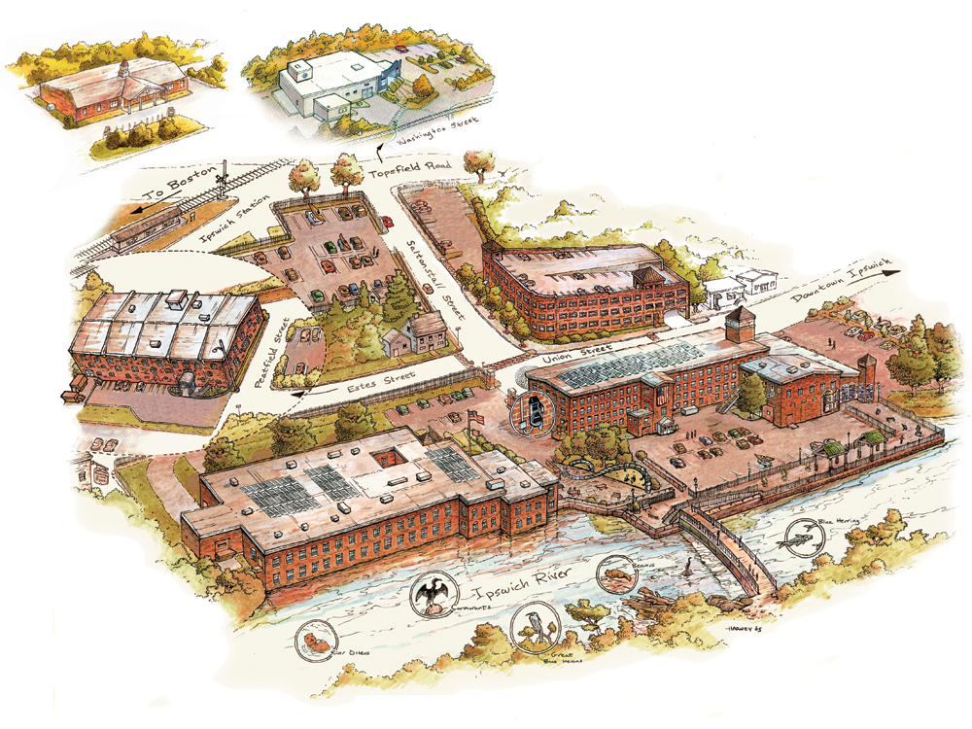
The EBSCO Campus – Ipswich, MA (46 km North of Boston)

Slide 5
EBSCO Industries Background
71 years serving the information needs of institutions
5,700 employees
1,100+ employees outside the U.S
100,000 organizations around the world use EBSCO products and services
200 million searches per day in EBSCO’s online research service, one of the busiest for-fee search platforms in the world
EBSCO Overview

Slide 6
EBSCO Information Services
Leading Online Research Service Provider to Institutions
375+ databases via EBSCOhost with 132 million+ records
3,000+ employees in EBSCO Information Services
Aggregator, Publisher and Distributor
License content from over 90,000 publications
Leading eBook distributor with nearly 700,000 books available
Discovery Service provider
Leading subscription agent and database provider
Only vendor involved in selling print and electronic subscriptions, online databases and eBooks
EBSCO Overview

Slide 7
Subscribers of EBSCO databases
London School of Economics
Tokyo University
Notes:
7
A s tím i počet uživatelů a našich partnerů.

Slide 8
Financial Times Global MBA Rankings 2012
Business School | Rank | Country
HKUST Business School | 1 | China
London Business School | 2 | UK
New York University (Stern) | 3 | USA
Tsinghua University | 4 | China
National University of Singapore | 5 | Singapore
INSEAD | 6 | France
CEIBS | 7 | China
University of Pennsylvania (Wharton) | 8 | USA
Washington University | 9 | USA
University of Chicago | 10 | USA
Sun Yat-sen Business School | 11 | China
Korea University Business School | 12 | Korea
“Business Source is certainly our number one research tool...”
– Mike Halperin, Library Director The Wharton School
All of the above are Business Source customers

Slide 9
Providing Research Databases/eBooks/Discovery Services and other Content for corporate customers
Corporate Research
Corporate Learning
Consumer Health Solutions

Slide 10
Subscribers of EBSCO databases
in Latvia

Slide 11
EBSCOhost is the world’s most-used for-fee online research service for colleges & universities, public libraries and schools.
EBSCO provides access to millions of users worldwide and processes more than 200 million searches every day. EBSCO is able to deliver results to end users on average less than 3 seconds.
Our data center comprises of thousands of servers—both physical and virtual—in three proprietary data centers as well as Amazon cloud centers and other Content Delivery Networks. Our global storage is about an Exabyte.
1 EB = 1000⁶bytes = 10¹⁸bytes = 1000000000000000000B = 1000 petabytes = 1million terabytes = 1billion gigabytes.
One of EBSCO’s State-of-the-Art Data Centers
Notes:
We were not software company. No we are.
Several state-of-the-art handling 60 million searches per day
Different power grids and different fiber connectivity

Slide 12
_{EBSCO databases are available}
_{in Latvia since end 1999}
_{Access organized by}
Culture Information Systems Centre
eIFL package in Latvia
Academic Search Complete
ERIC
European Views of the Americas
GreenFile
Health Source: Academic Edition
Health Source: Consumer Edition
Library, Information Science & Technology Abstracts
MasterFile Premier
MEDLINE
Newspaper Source
Regional Business News
Teacher Reference Center

Slide 13
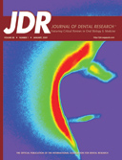
Academic Libraries subscribe to additional subject-specific databases
and eBooks
Subject-specific databases
eBooks
Art Source
Business Source Complete
Communication & Mass Media Complete
Computers & Applied Sciences Complete
EconLit with Full Text
Education Source
Legal Source
PsycARTICLES
SocINDEX with Full Text
Dentistry & Oral Sciences Source
DynaMed
Medline with Full Text
Military & Government Collection
INSPEC
Film&Television Literature Index with Full Text
International Bibliography of Theatre&Dance with Full Text
eBook Academic Collection

Slide 14
EBSCO uses many criteria for measuring
quality of journals to include in full-text databases
Measurement criteria include:
Licensing of unique journals not available in nearly every electronic collection of academic libraries
Indexing and high usage in important subject indexes:
Web of Science
Scopus
Journal Ranking Studies (JRS)
Eigenfactor
Peer Reviewed

Slide 15
EBSCO databases cover all subject area
Art and Architecture
Applied sciences and technology
Engineering and computer sciences
Physics and Mathematics
Medicinie and biomedicine
Biznes and economics
Agriculture and ecology
Humanities
Social sciences
Law
and many others …

Slide 16
EBSCO offers the leading subject indexes
AGRICOLA
America: History and Life
Applied Science & Technology Abstracts
Art Abstracts
ATLA Religion Database
Avery Index to Architectural Periodicals
Biological Abstracts
Business Source
CAB Abstracts
CINAHL
Criminal Justice Abstracts
EconLit
Education Abstracts
ERIC
FRANCIS
GeoRef
Historical Abstracts
Humanities Abstracts
Index Islamicus
Index to Legal Periodicals
Inspec
MEDLINE
MLA International Bibliography
Music Index, The
NTIS
PASCAL
Philosopher’s Index
PsycINFO
RILM Abstracts of Music Literature
SocINDEX
SPORTDiscus
Other

Slide 17
Academic Search
Complete

Slide 18
The Most Comprehensive, Scholarly Full-Text Database
for Multidisciplinary Research
DATABASE | Full-Text Journals | Full-Text Peer-Reviewed Journals | Active Full-Text Peer-Reviewed Journals
Academic Search Complete | 9,029 | 7,876 | 6,540
January 2015
Academic Search Complete

Slide 19
Examples of full-text journals in Academic Search Complete
Acta Toxicologica
Adsorption Science & Technology
Advances in Applied Mathematical Analysis
Advances in Fuzzy Mathematics
Advances in Theoretical & Applied Mathematics
Advances in High Energy Physics
American Journal of Pharmaceutical Education
American Journal of Psychiatric Rehabilitation
Archives of Civil & Mechanical Engineering
Archives of Psychiatry & Psychotherapy
Behaviour Change
Biophysical Reviews & Letters
British Journal of Psychotherapy
Clinical Medicine
Clinical Psychologist
Communications in Mathematical Analysis
Counseling Psychology Review
Critical Care Research & Practice
Academic Search Complete

Slide 20
Examples of full-text journals in Academic Search Complete
Engineering Letters
Eurasian Journal of Analytical Chemistry
European Journal of Developmental Psychology
European Journal of Jewish Studies
Global Journal of Pure & Applied Mathematics
Harvard Asia Quarterly
Harvard Human Rights Journal
Harvard Journal of Law & Technology
Harvard Latino Law Review
Harvard Negotiation Law Review
Insect Science
Integrative Zoology
Interdisciplinary Journal of Research on Religion
International Journal of Applied Chemistry
International Journal of Applied Engineering Research
International Journal of Applied Psychoanalytic Studies
International Journal of Chemical Kinetics
Academic Search Complete

Slide 21
Examples of full-text journals in Academic Search Complete
International Journal of Communication Systems
International Journal of Dynamics of Fluids
International Journal of Food Engineering
International Journal of Mechanics & Solids
International Journal of Molecular Sciences
International Journal of Multiphysics
International Journal of Number Theory
International Journal of Oceans & Oceanography
International Journal of Petroleum Science & Technology
International Journal of Psychology & Psychological Therapy
International Journal of Quantum Chemistry
International Journal of Stroke
International Journal of Theoretical & Applied Mechanics
Academic Search Complete

Slide 22
Examples of full-text journals in Academic Search Complete
International Journal of Zoology
Interpretation Journal
Iowa Law Review
Journal of Agricultural Sciences
Journal of Applied Biological Sciences
Journal of Cancer Research & Therapeutics
Journal of Chemical Sciences
Journal of Computational Chemistry
Journal of Diabetes Research
Journal of Engineering Education
Journal of Experimental Nanoscience
Journal of Food Science
Journal of Integrative Plant Biology
Journal of Islamic Studies
Journal of Mathematical Chemistry
Journal of Nanomaterials
Journal of Neurological Sciences
Journal of Neuropsychology
Journal of Petroleum Geology
Academic Search Complete

Slide 23
Examples of full-text journals in Academic Search Complete
Journal of Physical Organic Chemistry
Journal of Popular Music Studies
Journal of Renewable & Sustainable Energy
Journal of the Acoustical Society of America
Journal of Youth Studies
Legal Studies
Mathematical Modelling of Natural Phenomena
Molecular Systems Biology
New Oxford Review
Progress in Physics
Remote Sensing
Stanford Law Review
UCLA Law Review
Academic Search Complete

Slide 24
Nearly 150 Journals with Full Text Back to 1975 or Further
Back to 1929
Back to 1975
Back to 1911
Back to 1945
Back to 1920
Back to 1930
Back to 1975
Back to 1954
Back to 1971
Academic Search Complete

Slide 25
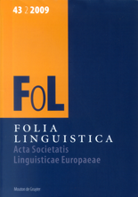
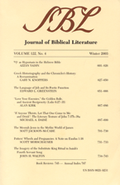
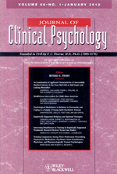
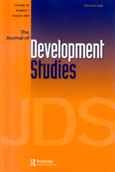
Nearly 150 Journals with Full Text Back to 1975 or Further
Back to 1967
Back to 1975
Back to 1975
Back to 1955
Back to 1973
Back to 1945
Back to 1967
Back to 1964
Back to 1964
Academic Search Complete

Slide 26
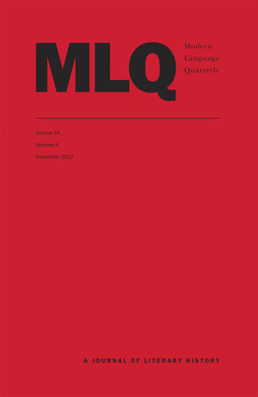
Nearly 150 Journals with Full Text Back to 1975 or Further
Back to 1975
Back to 1945
Back to 1975
Back to 1975
Back to 1940
Back to 1975
Back to 1967
Back to 1962
Back to 1973
Academic Search Complete

Slide 27
Academic Search Provides Full Text for Journals Indexed Within Leading Social Sciences & Humanities Databases (These statistics illustrate the extent of Humanities coverage in each full-text database)
 | ATLA Religion | ERIC | Historical Abstracts | MLA International Bibliography | PsycINFO | Science Citation Index (ISI)
Academic Search Complete | 346 | 622 | 372 | 451 | 709 | 825
Academic Search Complete

Slide 28
Academic Search Provides Full Text for Journals Indexed Within Leading Science Databases (These statistics illustrate the extent of STM coverage in each full-text database)
 | AGRICOLA | Biological Abstracts | CAB Abstracts | Chemical Abstracts | E.I. Compendex | GeoRef | Inspec | Science Citation Index (ISI) | SCOPUS
Academic Search Complete | 413 | 824 | 1,461 | 276 | 583 | 494 | 685 | 825 | 5,068
Academic Search Complete

Slide 29
Business Source
Complete

Slide 30
Business Source Complete
CONTENT TYPE | Business Source Complete
Author Profiles | 40,654
Books & Monographs | 853
Case Studies | 11,081
Company Information Records | 1,160,151
Conference Papers / Proceedings Collections | 69
Country Economic Reports | 1,247
Faculty Seminars (Videos) | 57
Industry Reports | 7,368
Interviews (Executive & Analyst) | 9,399
Market Research Reports | 2,556
Peer-Reviewed Journals | 1,990
SWOT Analyses | 3,682
Trade Journals & General Business Magazines | 1,831
Working Papers Collections | 33
Figures as of December, 2014
Business Source Complete

Slide 31
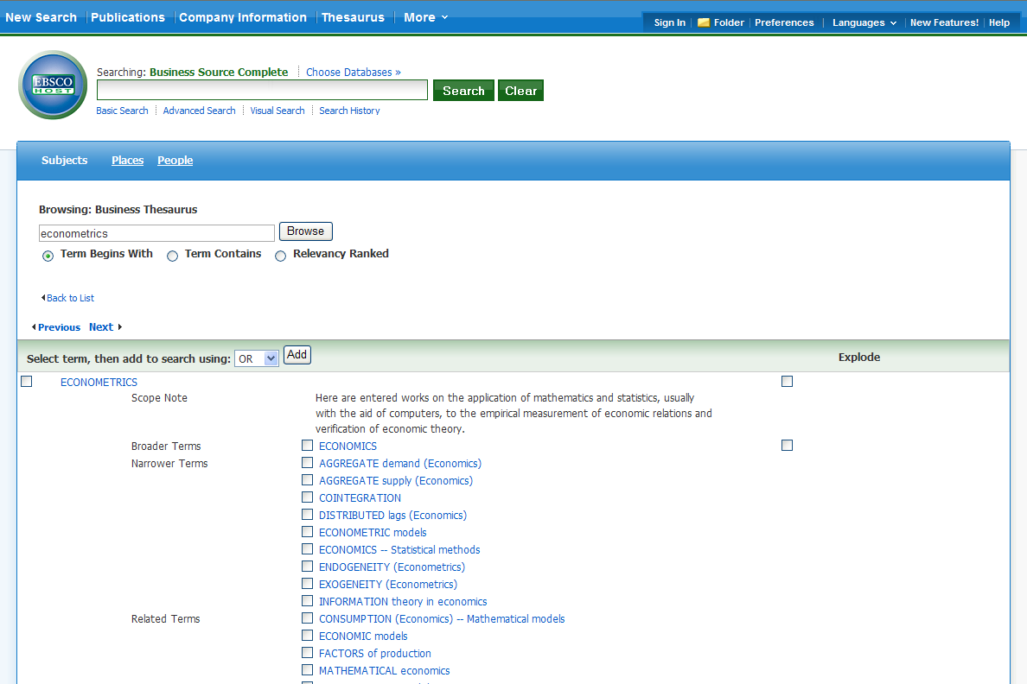
Business Source Contains a High Quality Thesaurus
36,211
Ability to Explode Searches (similar to MEDLINE)
business- specific terms

Slide 32
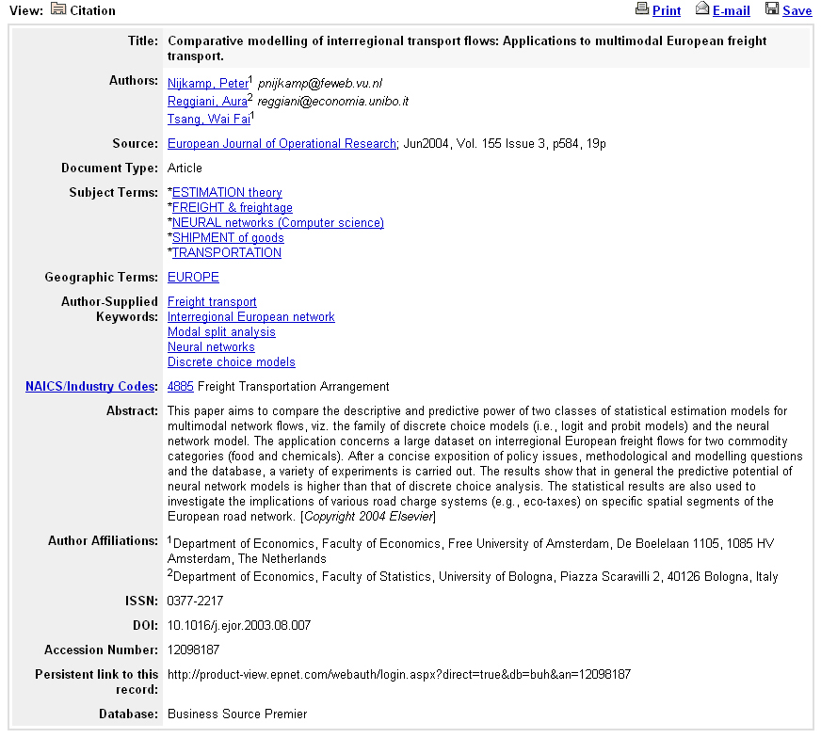
Enhanced Bibliographic Record – Business Source Complete
author email addresses
thesaurus terms
author supplied keywords
author supplied abstracts

Slide 33
Searchable Cited References (with links to full text)
Business Source Complete
1,130 peer-reviewed journals have searchable cited references starting with January 2003 issues (or earlier)
Only 223 journals are contained in ISI’s Business Collection
Searchable Cited Reference with links to the full text of the original cited work (when available)
Times Cited in this Database provides a list of all other papers in the database that cite this work (with links to the full text when available)
Business Source Complete

Slide 34
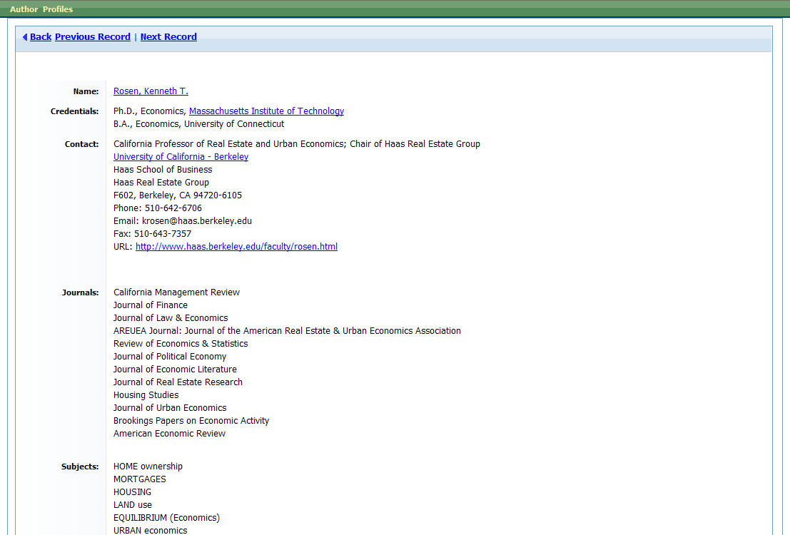
Business Source Complete: Author Profile
BSC provides author profiles for the 40,654
most cited
authors in the database.

Slide 35
International Full-Text Coverage in Business Source Complete
REGION | Full-Text Serials (Total) | Full-Text Peer-Reviewed Journals
Africa | 12 | 7
Australia & New Zealand | 99 | 34
Canada | 78 | 21
Caribbean Islands | 2 | 1
Central / South America | 52 | 45
Eastern Europe | 151 | 111
Far East | 668 | 175
Middle East | 56 | 50
United States | 6,455 | 705
Western Europe | 7,424 | 841
TOTAL | 14,997 | 1,990
Figures as of November 18, 2014
Business Source Complete

Slide 36
Business Source Complete Country Economic Reports
PUBLISHER | Business Source Full Text Coverage
Business Monitor International | 80 Country Forecast Reports
CountryWatch Incorporated | 196 Country Reviews
CountryWatch Incorporated | 196 Forecast Briefs
Global Insights | 114 Country Monitors
Going Global | 47 Career Guides
December, 2014
Business Source Complete

Slide 37
Business Source Complete Country Economic Reports
PUBLISHER | Business Source Full Text Coverage
MarketLine | 63 Country Profiles
OECD | 71 Country Economic Reports
Political Risk Yearbook | 100 Country Risk Reports
Superintendent of Documents | 195 Country Fact Sheets
Superintendent of Documents | 198 Country Background Notes
December, 2014
Business Source Complete

Slide 38
57 Harvard Faculty Seminars (Videos)
The Faculty Seminar Series features the work and research of prominent professors and experts from Harvard Business Schools
Topics Include:
Case Method
Change
Communications
Ethics
Finance and Accounting
Global Business
Governance
Innovation & Entrepreneurship
Leadership
Management
Organizational Behavior
Organizational Development
Sales & Marketing
Social Enterprise
Strategy
Technology & Operations
Business Source Complete

Slide 39
Sample Seminars Available via the Collection
Authentic Leadership
William W. George
What is authentic leadership? How can you become and remain an authentic leader? In this timely presentation, Professor William George outlines what it means to be a leader. Leadership is not about style or emulating another leader. It’s about responsibility and stewardship. A true leader appeals not only to people’s minds, but to their hearts, as leaders demonstrate through their vision and values. Topics covered: Leadership.
Building Strategy-Focused Organizations with the Balanced Scorecard
Robert S. Kaplan
Is your organization strategically focused? If not, you may need to consider developing a Balanced Scorecard strategy map. Professor Robert S. Kaplan first outlines the development of a Balanced Scorecard and describes its use by many successful organizations. Then he uses case studies of successful for-profit and nonprofit organizations to describe how to take the process to the next level, into strategic implementation, using a Balanced Scorecard strategy map. Topics covered: Finance and Accounting; Strategy.
International Entrepreneurial Finance
Walter Kuemmerle
How will a global perspective increase my organization’s likelihood of financial success? What’s most important to consider in local adaptation—economic, political, or social issues? In this presentation, Professor Walter Kuemmerle offers important insights for anyone thinking about starting up or expanding a business in an international context. Topics covered: Finance and Accounting; Global Business; Innovation and Entrepreneurship.
Business Source Complete

Slide 40
Sample Seminars Available via the Collection
Entrepreneurial Marketing
Joseph B. Lassiter III
Products, customers, people, and partners: How do they relate and why should you care? The right combination is critical for success in any venture—an established company or a start-up. Professor Joseph Lassiter combines the entrepreneur’s pursuit of an idea with marketing’s focus on the customer to create a process that can dramatically increase any organization’s performance. Topics covered: Innovation and Entrepreneurship; Management; Strategy.
Boom and Bust in Private Equity
Josh Lerner
What does the past tell us about the future of private equity? Are booms and busts a fact of life or a preventable anomaly? Professor Josh Lerner outlines three themes—rightsizing, structure and reach, and transparency—that may be dominant issues in private equity in the future. His conclusion: the business of private equity will look very different a decade from now. Topic covered: Finance and Accounting.
The New Strategic Weapon: Information Technology
F. Warren McFarlan
Information technology is not just back-office technology; it is a strategic weapon in today’s post-dot-com environment. IT makes companies survive, excel, and win. Professor F. Warren McFarlan expands on this theme amid IT’s strands of stability and change, and his insights help you understand where IT is today and predict where it will go in the next forty years. Topics covered: Management; Strategy; Technology and Operations.
Business Source Complete

Slide 41
Sample Seminars Available via the Collection
Brand Positioning
Youngme E. Moon
Have you positioned your brand to best engage the interest of potential customers? Professor Youngme E. Moon cites numerous examples of companies, such as JetBlue, IKEA, and Sony, whose unorthodox approaches have allowed them to steal share from all segments of the market. She presents four positioning strategies—iconic, reverse, breakaway, and stealth positioning—that such companies have used to dominate their product categories. Her insights and analyses can help you to position your product to its best advantage. Topics covered: Innovation and Entrepreneurship; Sales and Marketing; Strategy.
The Danger of Silencing Conflict at Work
Leslie A. Perlow
The best way to pacify workplace conflict is to keep quiet and not make any waves, right? Wrong. Professor Leslie A. Perlow uses three studies to show that silencing conflict can have devastating negative task and relationship consequences. Silencing conflict can cause tasks to take longer or never get done at all. Topics covered: Communications; Management; Organizational Behavior.
Where Do Great Strategies Come From?
Jan W. Rivkin
Are your strategic planning processes successful? Do they provide strategies that allow you to attain and maintain excellence in your industry for the long run? Professor Jan W. Rivkin feels that the traditional strategic planning process is flawed, and he presents an alternative, complementary approach. Using three tests of good strategic consistency and employing the case of Ryanair as an example, Professor Rivkin provides concrete advice for successful strategic planning in today’s dynamic environment. Topics covered: Leadership; Strategy.
Business Source Complete

Slide 42
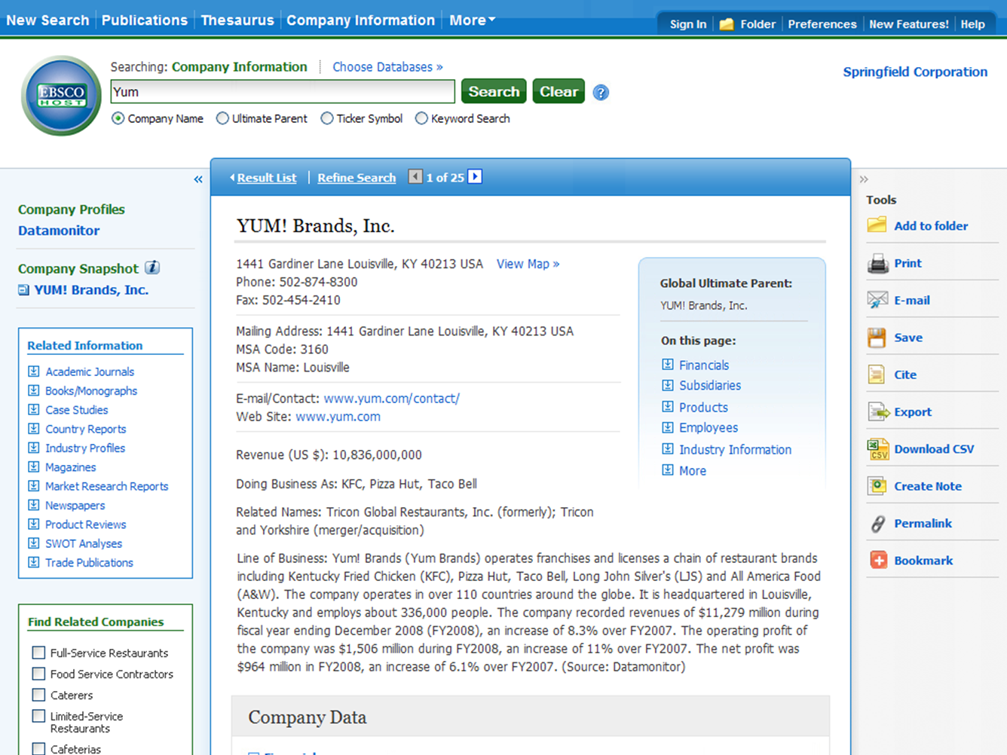
Company View on Business Source Complete
Notes:
42

Slide 43
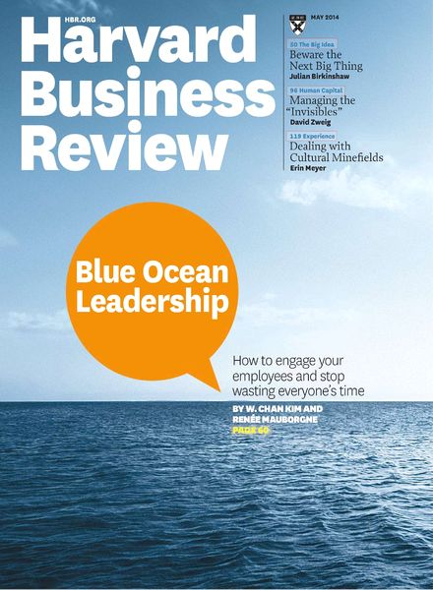
Top Five General Business Magazines
Business Source Complete Full Text Coverage
Magazine Name
Journal Name
Bloomberg Businessweek
Active Full Text, NO Embargo
Forbes
Active Full Text, NO Embargo
Fortune
Active Full Text, NO Embargo
Harvard Business Review
Active Full Text, NO Embargo
Money
Active Full Text, NO Embargo
Business Source Complete

Slide 44
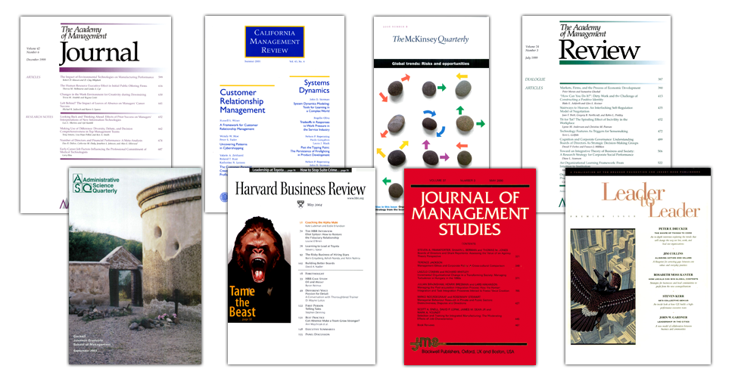
The world’s leading collection of full-text management journals, including active full text for hundreds of top publications

Slide 45
Accounting Hundreds of Full-Text Magazines & Journals

Slide 46
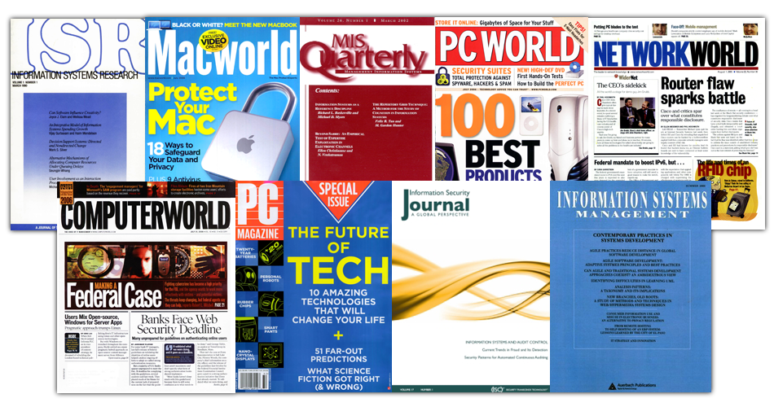
MIS Hundreds of Full-Text Magazines & Journals

Slide 47
Sales & Marketing Hundreds of Full-Text Magazines & Journals

Slide 48
Art Source covers a broad range of related subjects from fine, decorative and commercial art, to various areas of architecture and architectural design.
Includes periodicals published in French, Italian, German, Spanish and Dutch and is designed for use by a diverse audience, including art scholars, artists, designers, students and general researchers.us areas of architecture and architectural design.
Over 750 full-text journals and more than 220 full-text books
Detailed indexing and abstracts for many leading academic journals, magazines and trade publications
An Image Collection of over 63,000 images provided by Picture Desk and other sources
Art reproduction records
And much more…

Slide 49
Subjects Include:
Advertising
Art Antiques
Archaeology
Architecture & Architectural History
Art History
Contemporary Art
Costume Design
Crafts
Decorative Arts
Folk Art
Graphic Arts
Industrial Design
Interior Design
Landscape Architecture
Motion Pictures
Museology
Non-Western Art
Painting
Photography
Pottery
Printmaking
Sculpture
Television
Textiles
Video
And many others…

Slide 50
Communication Source is the premier research database for Communication Studies
Offers worldwide full-text content pertaining to communication, linguistics, rhetoric and discourse, speech-language pathology, media studies and related fields and includes many unique sources previously not available.
Designed for scholars and students in Communication and related disciplines.
Communication Source covers full text for more than 840 titles, including over 600 active full-text journals and 150 full-text journals not found in other EBSCO academic databases.

Slide 51
Content Includes:
Active full text for more than 600 journals
Indexing and abstracting is included for more than 1,100 Core titles.
Subject-specific, browsable thesaurus featuring over 4,600 preferred and over 8,700 non-preferred terms
Also featured is backfile coverage of top titles in Communication, reaching deep into the 20th century.
Content comes from academic journals, conference papers, conference proceedings, trade publications, magazines and periodicals.
Coverage dating back to 1915

Slide 52
Applied Science & Technology Source
Includes full text for 1,400 journals
High-quality indexing and abstracts for thousands of academic journals, professional publications and other reference sources—produced by professionals with advanced degrees in science
Citations to millions of articles, including book reviews
Covers the full spectrum of the research and development of the applied sciences and computing disciplines.
Provides content from leading trade and industrial journals, professional and technical society journals, specialized subject periodicals, buyers’ guides, directories, conference proceedings and more
Provides comprehensive coverage for a wide variety of applied science specialties — from acoustics to aeronautics, and neural networks to nuclear engineering.

Slide 53
Subjects Include:
Geology
Machinery
Marine Technology
Metallurgy
Mineralogy
Neural Networks
New Technologies
Optical & Neural Computing
Plastics
Robotics
Solid State Technology
Space Science
Textile Industry & Fabrics
And many others…
Acoustics
Aeronautics
Applied Mathematics
Artificial Intelligence
Chemistry
Communication & Information Technology
Computer Databases & Software
Computer Theory & Systems
Energy Resources & Research
Engineering & Biomedical Materials
Engineering Disciplines
Food & Food Industry

Slide 54
Full-Text Science & Technology Databases Compared
DATABASE | Full-Text Journals | Full-Text Journals Not Available in Any Version of Academic Search
Computers & Applied Sciences Complete | 1,019 | 648
Applied Science & Technology Source | 1,353 | 977
Figures as of February 2015

Slide 55
Applied Science & Technology Source is the world’s largest full-text companion to Inspec
Inspec is an index to 4,525 science & technology journals
Applied Science & Technology Source = 1,353 full-text science & technology journals
547 are also indexed in Inspec
806 are full-text applied science & technology-related journals NOT indexed in Inspec

Slide 56
Education Source includes many unique sources not previously available.
Covers scholarly research and information to meet the needs of education students, professionals and policy makers.
Offers the world's largest and most complete collection of full-text education journals, and encompasses an international array of English-language periodicals, monographs, yearbooks and more
Education Source covers all levels of education—from early childhood to higher education—as well as all educational specialties, such as multilingual education, health education and testing.

Slide 57
Content includes:
Full text for over 1,800 journals
Indexing and abstracts for thousands of journals
Full text for more than 550 books and monographs
Full text for numerous education-related conference papers
Citations for over 5 million articles, including book reviews
And much more…

Slide 58
Humanities Source offers worldwide content pertaining to literary, scholarly and creative thought and is the most comprehensive resource available in its field
Provides full text for more than 1,480 journals and abstracts and bibliographic indexing for the most noted scholarly sources in the humanities
Includes articles, interviews, obituaries, bibliographies, original works of fiction, book reviews, and reviews of ballets, dance programs, motion pictures, musicals, operas, plays, and much more
A valuable collection for students, researchers and educators interested in all aspects of the humanities
High-quality indexing and in-depth abstracts for thousands of journals
Millions of records
A unique subject thesaurus
And much more…

Slide 59
Subjects include:
Linguistics
Literary & Social Criticism
Literature
Music
Performing
Arts
Philosophy
Religion & Theology
And many others
Archaeology
`Area Studies
Art Classical Studies
Communications
Dance
Film
Folklore
Gender Studies
History
Journalism

Slide 60
Legal Source provides full-text for 880 journals of the world's most respected scholarly law journals
Provides more than 300 law reviews
Over 2.5 million records, including book reviews and case studies
An excellent resource for attorneys, educators, business people, law librarians, students, paralegals, and others involved with the law.
Offers information in law and legal topics such as criminal justice, international law, federal law, organized crime, medical law, labor and human resource law, ethics, the environment and much more.
Users will appreciate the international coverage and access to scholarly articles, symposia, jurisdictional surveys, court decisions, legislation, books, book reviews and more

Slide 61
Subjects include:
Administrative Law
Antitrust Law
Banking
Business Law
Constitutional Law
Criminal Law
Domestic Relations
Estate Planning
Family Law
Food, Drug & Cosmetic Law
Insurance Law
Intellectual Property Law
Internet & Information Science Law
Landlord/Tenant Law
Legal Librarianship
Multinational Corporations
Non-Profit Corporations
Patent & Trademark
Probate
Securities
Sports & Entertainment Law
Tax Law
Trade Regulation
And many others…

Slide 62
Central & Eastern European Academic Source

Slide 63
Central & Eastern European Academic Source (CEEAS)
Total Full-Text Journals | 540
Full-Text Journals That Overlap with ASC or BSC | 182
Full-Text Journals NOT Available via ASC or BSC | 358
* Comparison from December, 2014
Central & Eastern European Academic Source

Slide 64
Sample Full-Text Journals in CEEAS that are NOT found in any version of Academic Search or Business Source
Acta Historica Universitatis Klaipedensis
Acta Orientalia Vilnensia
Annals of the Náprstek Muzeum
Annals of the University of Craiova, Economic Sciences Series
Archaeologia Adriatica
Archaeologia Baltica
AUCO Czech Economic Review
Bosniaca
Central Europe
Central European Journal of Public Policy
Croatian Journal of Ethnology & Folklore Research/ Narodna Umjetnost
Discussions on Estonian Economic Policy
East European & Russian Yearbook of International & Comparative Law
Ethnicity Studies / Etniskumo Studijos
Central & Eastern European Academic Source

Slide 65
Sample Full-Text Journals in CEEAS that are NOT found in any version of Academic Search or Business Source
Experiment: A Journal of Russian Culture
Filosofija, Sociologija
Hungarian Quarterly
Journal of Baltic Studies
Journal of Criminal Justice Issues (Kriminalisticke teme)
Journal of the Cukurova University Institute of Social Sciences
Kvartal: Chronicle of Croatian Art History
Lietuvos Archeologija
Lingua (Language & Culture)
Linguistica Uralica
Lithuanian Foreign Policy Review
Litteraria Pragensia
Lituanistica
Macedonian Journal of Medical Sciences
Music & Society in Eastern Europe
New Balkan Politics
Central & Eastern European Academic Source

Slide 66
Sample Full-Text Journals in CEEAS that are NOT found in any version of Academic Search or Business Source
Oikos: Lithuanian Migration & Diaspora Studies
Památky Archeologické
Perekrestki
Polish Sociological Review
Revija za Sociologiju
Socialinis Darbas
Sociálni Studia / Social Studies
Sociologija: Mintis ir Veiksmas
Studia Universitatis Babes-Bolyai, Geographia
Studies of Lithuania's History
Transylvanian Review
Central & Eastern European Academic Source

Slide 67
Political Science
Complete

Slide 68
Political Science Complete
FULL-TEXT SOURCES | TOTAL | UNIQUE*
Full-Text Journals | 660 | 453
Full-Text Books & Monographs | 339 | 338
Full-Text Conference Papers | 44,328 | 44,328
* Not available as full text in any version of Academic Search
Compared January 2015
Political Science Complete

Slide 69
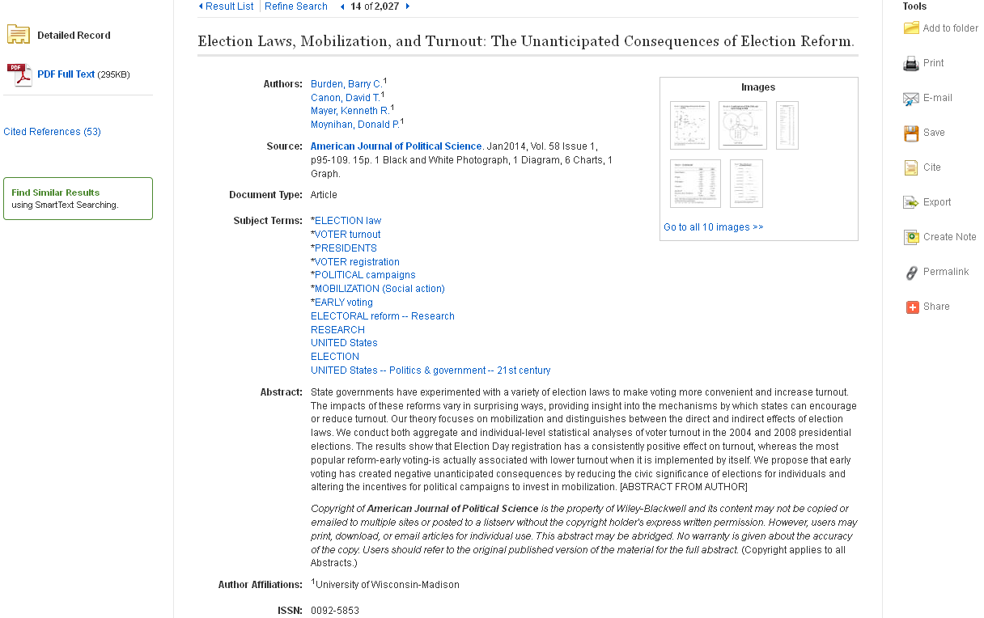
Sample Political Science Complete Record

Slide 70
Unique Full-Text Journals
American Diplomacy
Australian Journal of Public Administration
Canadian Parliamentary Review
Ethnopolitics
Hague Journal of Diplomacy
Journal of Civil Society
Journal of Human Rights Practice
Journal of Language & Politics
New Politics
Politics & Policy
Presidential Studies Quarterly
Religion & Human Rights
Review of International Law & Politics
Social Politics: International Studies in Gender, State & Society
NOTE: None of these are available in full text in any version of Academic Search
Political Science Complete

Slide 71
39,905 Unique Full-Text Conference Papers
Conference Papers -- American Political Science Association
Conference Papers -- International Studies Association
Conference Papers -- Midwestern Political Science Association
Conference Papers -- New England Political Science Association
Conference Papers -- Northeastern Political Science Association
Conference Papers -- Southern Political Science Association
Conference Papers -- Western Political Science Association
NOTE: None of these are available in full text in any version of Academic Search
Political Science Complete

Slide 72
Resources for Psychology Studies

Slide 73
The definitive source of full text, peer-reviewed scholarly and scientific articles in psychology
Offers more than 189,000 articles from over 80 journals published by the APA and allied organizations including the Canadian Psychological Association
Includes journal articles, book reviews, letters to the editor and errata from each journal
PsycARTICLES
Coverage from 1894 – present; nearly all APA journals
The world’s largest resource devoted to peer-reviewed literature in behavioral science and mental health
Contains more than 3.7 million citations and summaries
Includes abstracts of scholarly journal articles, book chapters, books and dissertations
PsycINFO dating back as far as the 1600s
The authoritative source of structured information about tests of interest to a variety of fields
Allows access to thousands of test instruments, most available for immediate download
Includes tests that were originally developed for research and were not made commercially available
PsycTESTS
Updated monthly, spans more than a century

Slide 74
Offers full-text book reviews featuring current scholarly and professional books in psychology
Includes nearly a dozen new reviews added each week
Includes reviews from a psychological perspective of popular films and trade books
PsycCRITIQUES
Contains 57,000 chapters in PDF from over 3,800 books by the APA and others
Offers 2,800 books of historical impact in psychology
Provides the exclusive electronic release of 1,500 authored entries from the APA/Oxford University Press Encyclopedia of Psychology
PsycBOOKS dating back as far as the 1600s
PsycEXTRA
A bibliographic and full-text companion to the scholarly PsycINFO® database
Includes coverage of gray literature relating to psychology and the behavioral sciences
Contains more than 330,500 records that are not indexed in any other APA database

Slide 76
MEDLINE Complete Active Full Text
MEDLINE Complete provides ongoing full text for 2,113 of the 5,623 journals currently indexed in MEDLINE
37.58%
Active Full Text
MEDLINE

Slide 77
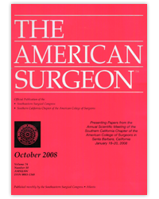
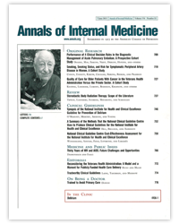
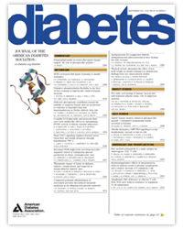
Active Full-Text Journals Found in MEDLINE Complete
1993 to present
2010 to present
1995 to present
1960 to present
No Embargo
No Embargo
No Embargo
No Embargo
1952 to present
1978 to present
1916 to present
1996 to present
No Embargo
No Embargo
No Embargo
12-Month Embargo

Slide 78
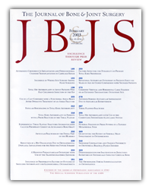
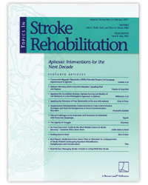
Active Full-Text Journals Found in MEDLINE Complete
1982 to present
No Embargo
No Embargo
No Embargo
1960 to present
No Embargo
No Embargo
No Embargo
No Embargo
Notes:
78

Slide 79
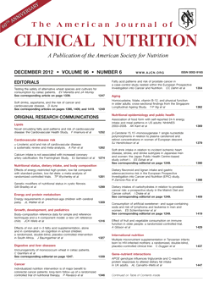
Active Full-Text Journals Found in MEDLINE Complete
1952 to present
1928 to present
2010 to present
No Embargo
No Embargo
No Embargo
Notes:
79

Slide 80
Paldies
Thank you
Teresa Górecka
tgorecka@ebsco.com

